Slide 1
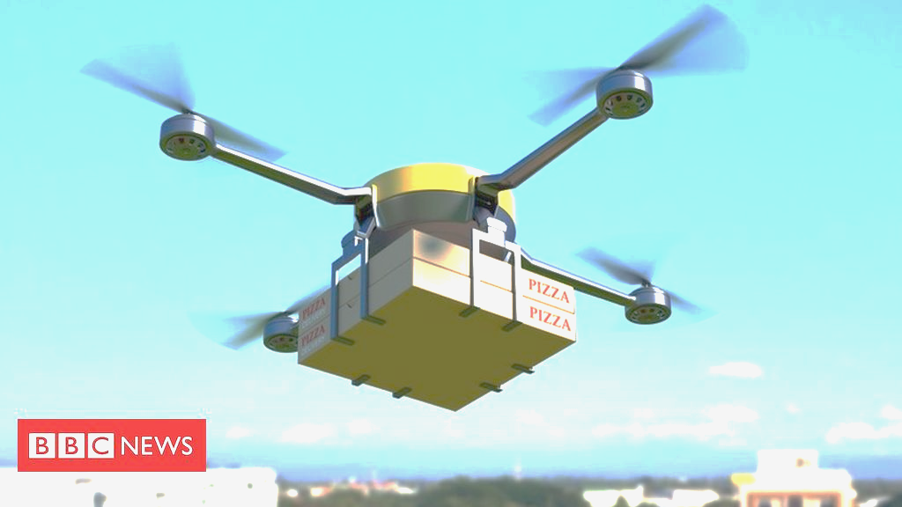
Drone Hub
Food Delivery System
Sankalp
Anderson Srivatsav
https://www.bbc.com/news/business-46483178

Slide 2
The Use Case / Persona
Family dinner
Wants different foods
Uses app to order
Doesn’t want to spend extra

Slide 3
One Stop App for Every Restaurant
Amazon for the Food
Mix and Match Orders
Efficient Delivery
Save Time & Money

Slide 4
Incumbent
Food App
Order 1
Order 2
Mcdonalds
The City
Car drives for many miles
Costumer
Chick-fil-A

Slide 5
Disruptor
Our App
1 Order
Mcdonalds
1 autonomous electrictric drone
The City
Hub
20 miles
20 miles
Costumer
Chick-fil-A

Slide 7
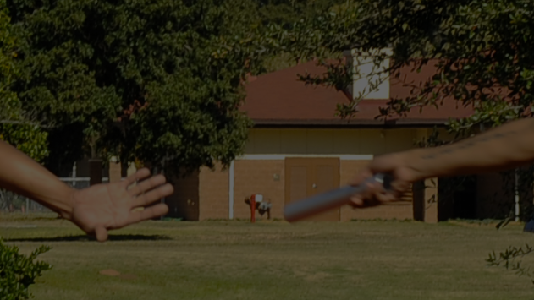
It’s like Relay Racing
https://media.defense.gov/2012/Nov/19/2000095478/-1/-1/0/121116-F-KN424-147.JPG

Slide 8
Competitive Advantages
Disruptive price
Disruptive speed
Flexible (merge/split orders)
Scaleable

Slide 9
Trail Blazers
Wireless ISPs (hardware)
Doordash (app)
Amazon (delivery)
Tesla (autopilot)

